Slide 1


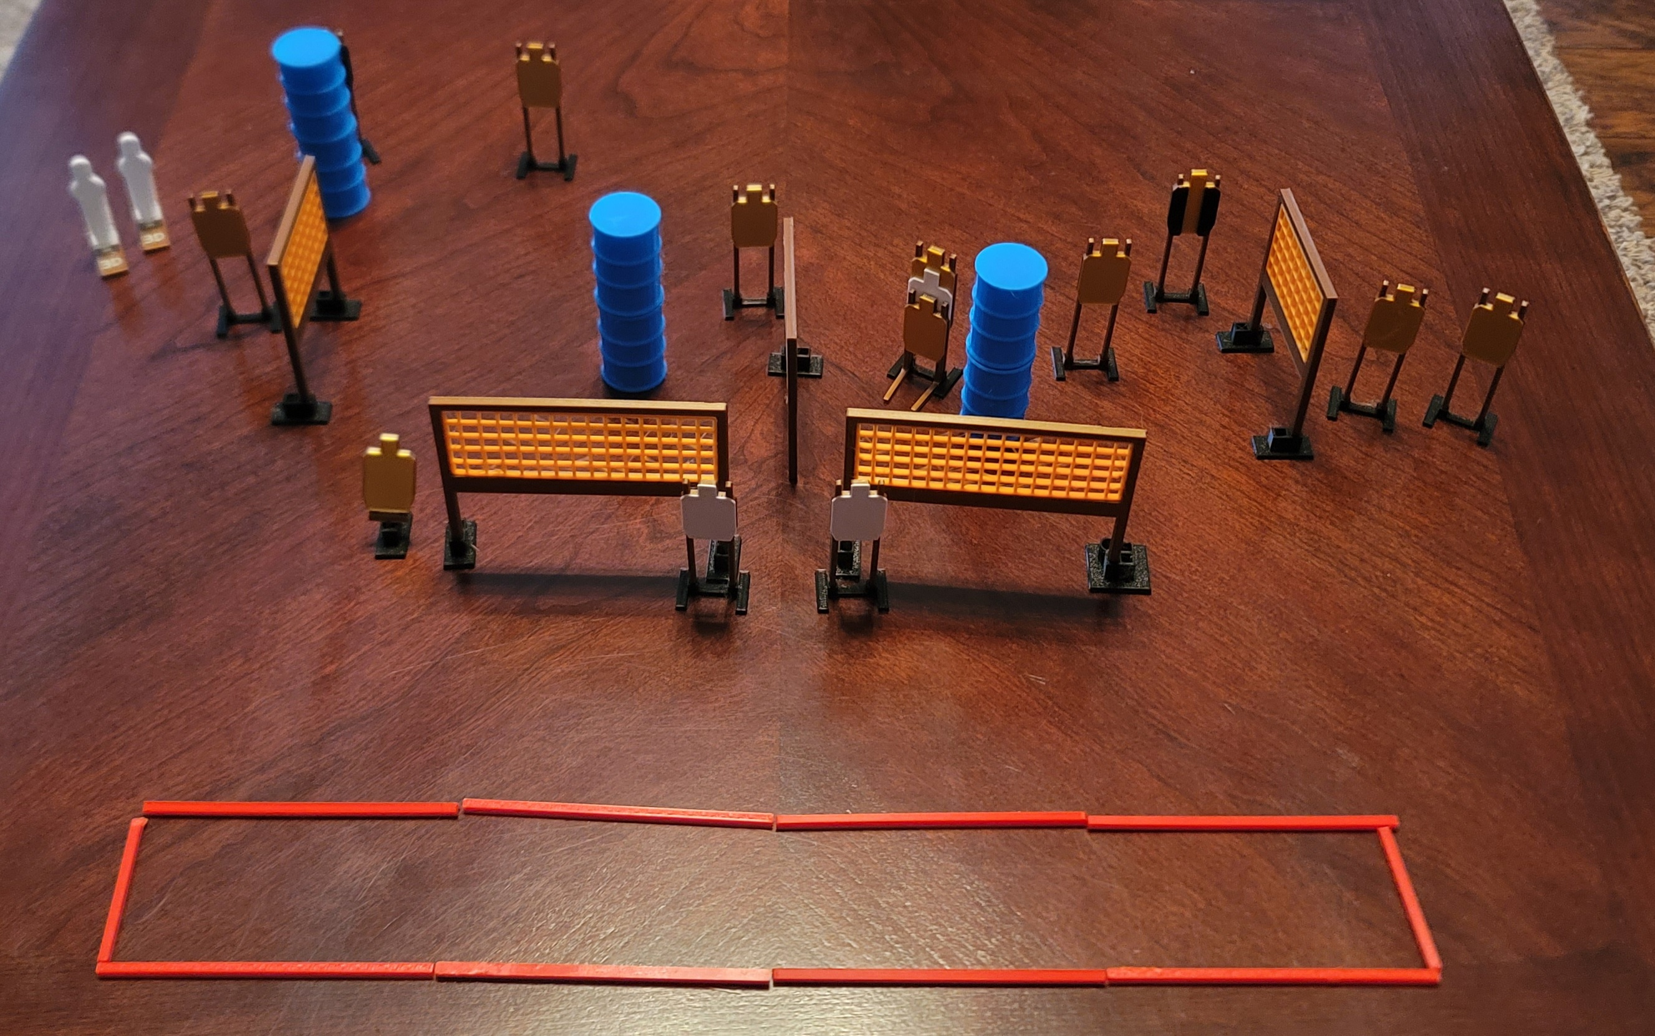
 | Dothan Gun Club – USPSA Match Tight Squeeze Course Designer : Eric Henwood Bay: 11
Round Count 24 rounds 11 USPSA, 2 colt poppers
Equipment List 10 wall feet 2 tux 12 targets (9 + 3 NS)

Slide 2
Tight Squeeze
Written Stage Briefing
Scoring: Comstock Rounds: 24
Targets: 11 USPSA, 2 steel
Handgun start position: anywhere completely outside the shooting area, wrists below belt. Handgun is loaded and holstered.
PCC start position: anywhere completely outside the shooting area, stock on belt. Loaded carbine is held with both hands, safety on.
Stage Procedure: on the audible start signal, engage targets as they become available from within he shooting area.

